Slide 1

KISHKINDA UNIVERSITY
DEPARTMENT OF COMPUTER SCIENCE & ENGINEERING
MAJOR PROJECT PHASE 2
A Swarm Intelligent Framework for Knowledge Transfer Between Heterogeneous Machine Learning Models in Multi Robot Systems
Presented By : Mr. Zaheed Hussain
(KUB24MCS018)
Project Guide
Dr. RAJASHREE V BIRADAR
CHAIRPERSON - CSE

Slide 2
TABLE OF CONTENTS
INTRODUCTION
LITERATURE SURVEY
EXISTING VS PROPOSED SYSTEM
PROBLEM STATEMENT
OBJECTIVES
SYSTEM DESIGN
RESULTS
CONCLUSION
REFERENCES

Slide 3
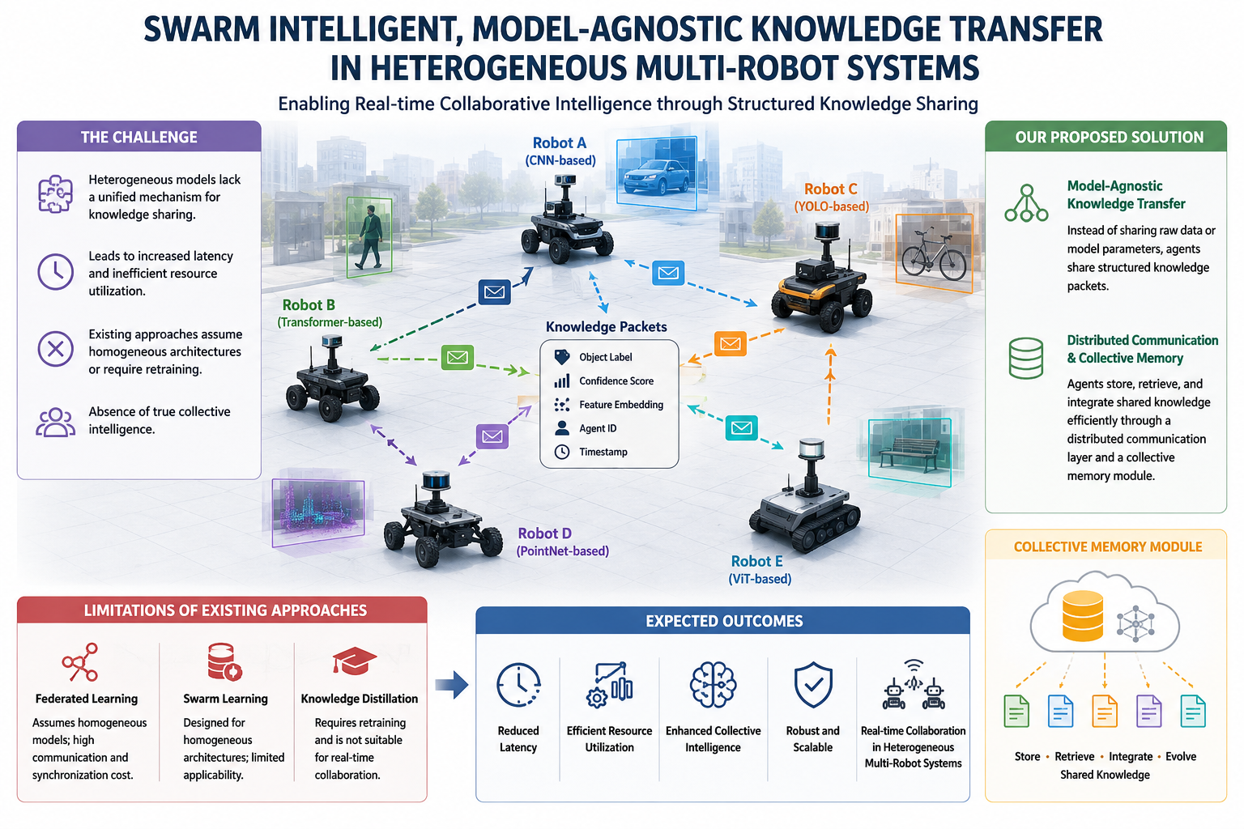
INTRODUCTION
1

Slide 4
INTRODUCTION
2
Modern multi-robot systems often employ diverse AI models such as CNNs, Transformers, YOLO, PointNet, and Vision Transformers.
Existing knowledge-sharing approaches are limited by model heterogeneity, communication overhead, and retraining requirements.
Enabling effective collaboration among heterogeneous robots remains a significant challenge.
This work proposes a Swarm Intelligent, Model-Agnostic Knowledge Transfer Framework that facilitates real-time knowledge sharing without exchanging raw data or model parameters.
A collective memory mechanism enables robots to store, retrieve, integrate, and evolve shared knowledge, fostering collaborative intelligence.

Slide 5
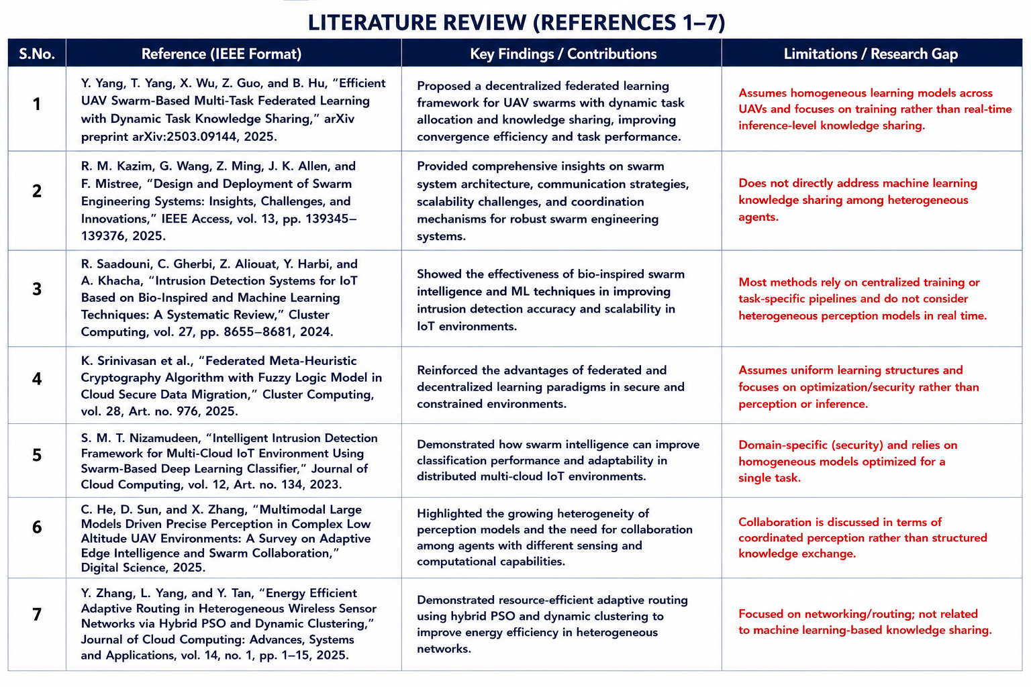
Literature Survey
4

Slide 6
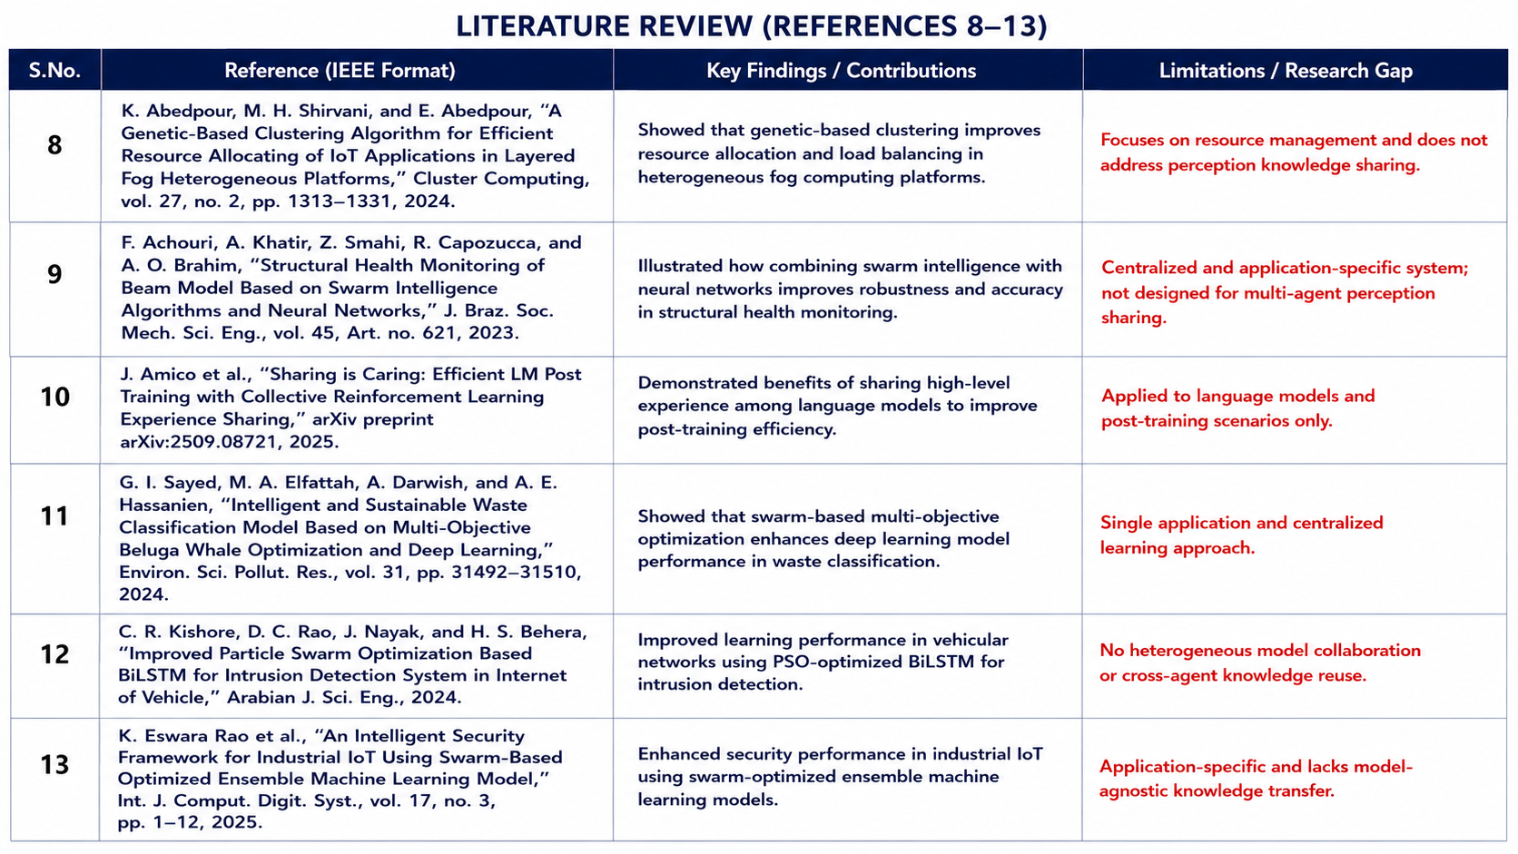
Literature Survey
4

Slide 7
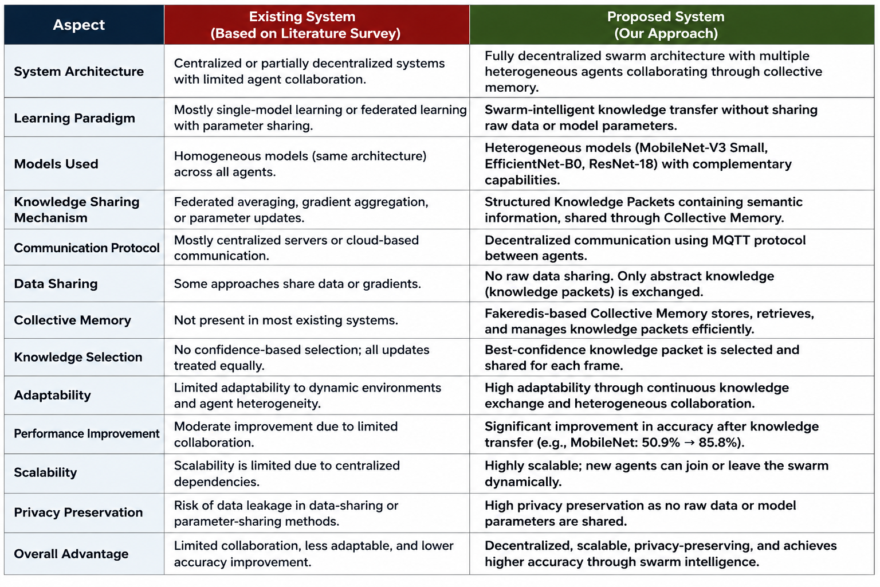
Existing vs Proposed System
3

Slide 8
6
Problem Statement
Heterogeneous machine learning models in multi-robot systems lack a unified mechanism for real-time knowledge sharing, leading to redundant inference and inefficient resource utilization.
To design and develop a decentralized swarm-intelligent framework for model-agnostic knowledge transfer among heterogeneous machine learning models.

Slide 9
7
Objectives
To design and develop a decentralized swarm-intelligent framework that enables knowledge sharing among heterogeneous machine learning models in multi-robot systems.
To design a knowledge packet mechanism that captures object labels, confidence scores, timestamps, and agent information for inter-agent knowledge sharing.
To implement a collective memory framework that stores and distributes the highest-confidence perception knowledge among agents, reducing redundant inference and storage.
To evaluate the impact of knowledge sharing on model performance, knowledge reuse, and inference efficiency through comparative analysis before and after knowledge transfer.

Slide 10
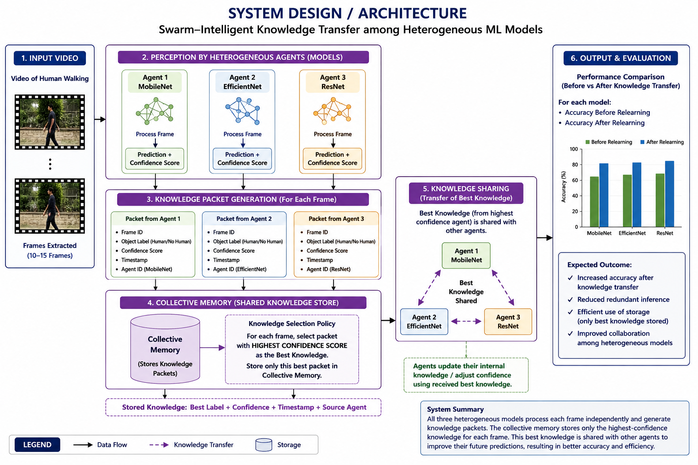
6

Slide 11
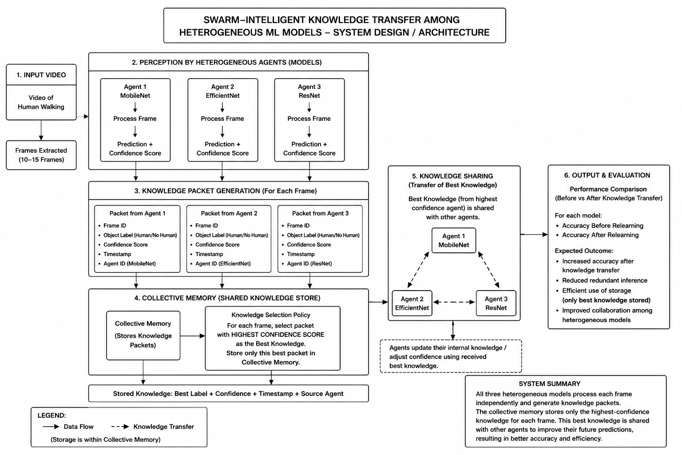
6

Slide 12
Methodology
10
Stage 1: Video Input & Frame Extraction, Input video is provided to the system.
Video is divided into multiple frames for analysis.
Each frame is processed independently.
Stage 2: Perception by Heterogeneous Agents - Multiple agents use different ML models.
Agent 1 – MobileNet, Agent 2 – EfficientNet, Agent 3 – ResNet
Each agent predicts the object class and confidence score.
Stage 3: Knowledge Packet Generation - Every agent creates a knowledge packet containing: Frame ID, Predicted Label, Confidence Score, Timestamp, Agent ID.

Slide 13
Methodology
11
Stage 4: Collective Memory Formation - Knowledge packets from all agents are stored.
For each frame, the packet with the highest confidence score is selected and Selected knowledge is stored in Collective Memory.
Stage 5: Swarm Knowledge Transfer - Best knowledge from Collective Memory is shared with other agents.
Agents update their internal understanding using received knowledge.
No model weights or raw data are exchanged.
Stage 6: Output & Evaluation - Agents perform prediction after knowledge transfer.
Accuracy before and after relearning is compared and Improvement in collaboration and decision-making is measured.

Slide 14
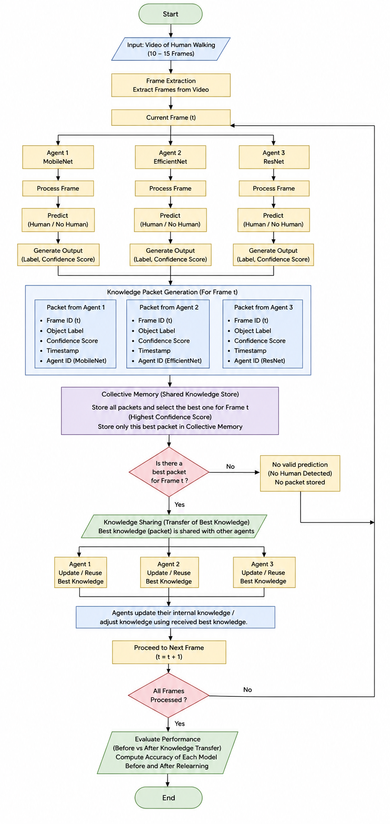
Flow Chart
12

Slide 15

Results
13

Slide 16
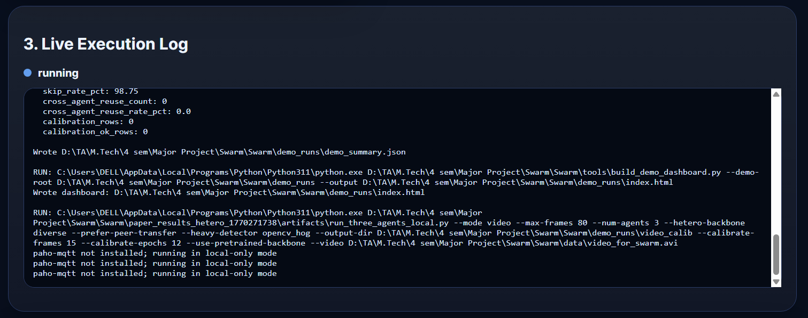
Results
14

Slide 17
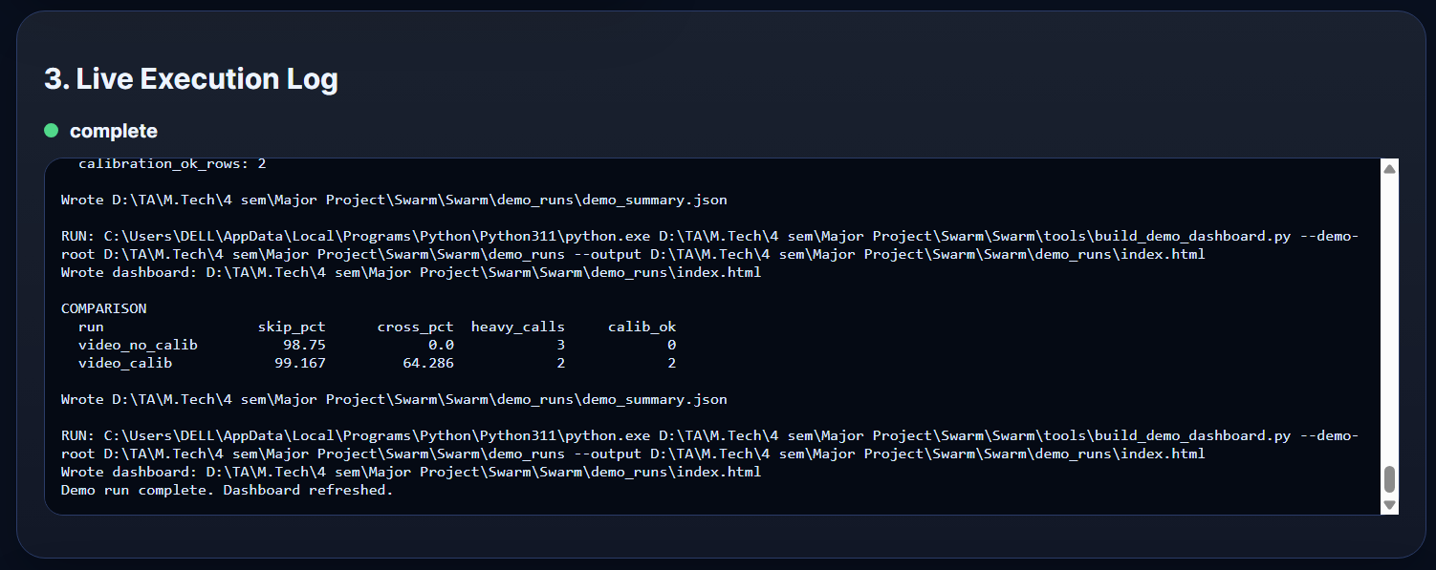
Results
15

Slide 18
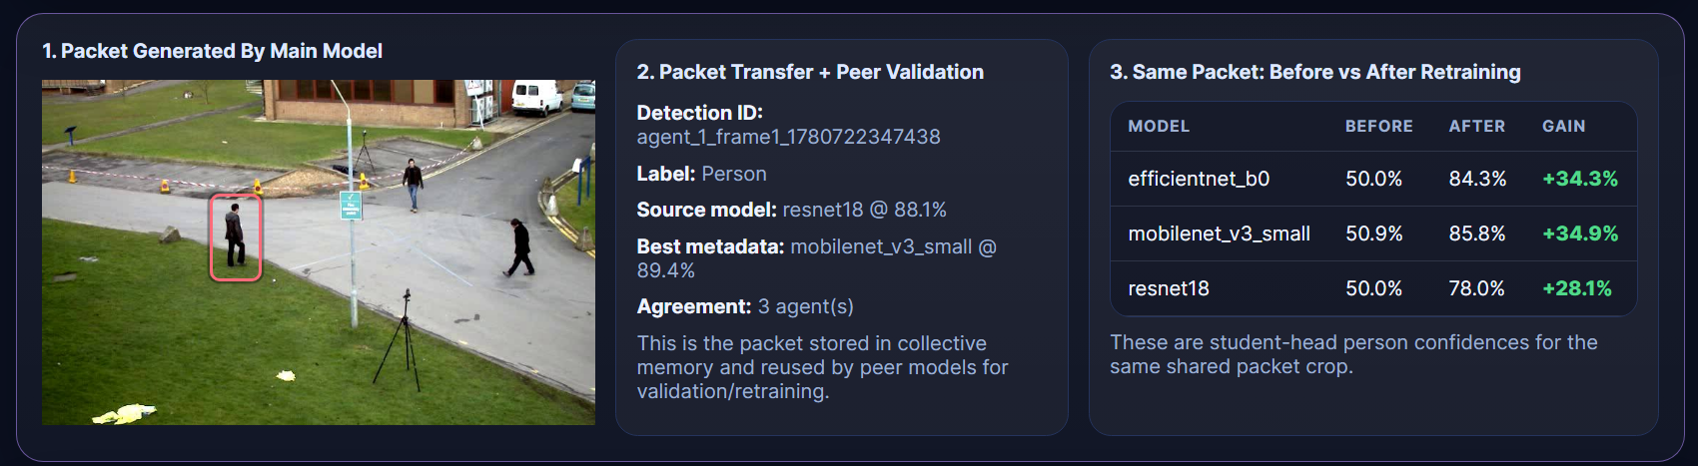
Results
16

Slide 19
17
Conclusion
The proposed framework successfully enables knowledge transfer among heterogeneous machine learning models through swarm intelligence. By sharing high-confidence knowledge packets via collective memory, the system reduces redundant inference, improves model performance, and demonstrates effective collaborative intelligence without exchanging raw data or model parameters.

Slide 20
References
Yubo Yang, Tao Yang, Xiaofeng Wu, Ziyu Guo, Bo Hu, “Efficient UAV swarm based multi task federated learning with dynamic task knowledge sharing,” arXiv preprint arXiv:2503.09144, Mar. 2025, doi: 10.48550/arXiv.2503.09144.
Raza Muhammed Kazim¹, Guoxin Wang^{1,2}, Zhenjun Ming^{1,2}, Janet K Allen³, Farrokh Mistree³, “Design and deployment of swarm engineering systems: Insights, challenges, and innovations,” IEEE Access, vol. 13, pp. 139345–139376, 2025, doi: 10.1109/ACCESS.2025.3592950.
Rafika Saadouni¹, Chirihane Gherbi¹, Zibouda Aliouat¹, Yasmine Harbi¹, Amina Khacha¹, “Intrusion detection systems for IoT based on bio inspired and machine learning techniques: A systematic review of the literature,” Cluster Computing, vol. 27, pp. 8655–8681, Oct. 2024, doi: 10.1007/s10586 024 04388 5.
Kannan Srinivasan et al., “Federated meta heuristic cryptography algorithm with fuzzy logic model in cloud secure data migration,” Cluster Computing, vol. 28, art. no. 976, 2025, doi: 10.1007/s10586 025 05627 z.
Syed Mohamed Thameem Nizamudeen¹, “Intelligent intrusion detection framework for multi clouds–IoT environment using swarm based deep learning classifier,” Journal of Cloud Computing, vol. 12, art. no. 134, 2023, doi: 10.1186/s13677 023 00509 4.
Chenchen He¹, Dongran Sun², Xuexue Zhang³, “Multimodal large models driven precise perception in complex low altitude UAV environments: A survey on adaptive edge intelligence and swarm collaboration,” Digital Science, 2025.
Yang Zhang¹, Ling Yang¹, Yan Tan², “Energy efficient adaptive routing in heterogeneous wireless sensor networks via hybrid PSO and dynamic clustering,” Journal of Cloud Computing: Advances, Systems and Applications, vol. 14, no. 1, pp. 1–15, Aug. 2025, doi: 10.1186/s13677 02500768 3.

Slide 21
References
Kimia Abedpour¹, Mirsaeid Hosseini Shirvani², Elmira Abedpour³, “A genetic based clustering algorithm for efficient resource allocating of IoT applications in layered fog heterogeneous platforms,” Cluster Computing, vol. 27, no. 2, pp. 1313–1331, 2024, doi: 10.1007/s10586 023 04005 x.
Fatima Achouri¹, Abdelwahhab Khatir², Zakarla Smahi³, Roberto Capozucca², Abdelmoumin Ouled Brahim², “Structural health monitoring of beam model based on swarm intelligence based algorithms and neural networks employing frequency response functions,” Journal of the Brazilian Society of Mechanical Sciences and Engineering, vol. 45, art. no. 621, Nov. 2023, doi: 10.1007/s40430 023 04525 y.
J. Amico et al., “Sharing is caring: Efficient LM post training with collective reinforcement learning experience sharing,” arXiv preprint arXiv:2509.08721, Sep. 2025, doi: 10.48550/arXiv.2509.08721.
Gehad Ismail Sayed^{1,6}, Mohamed Abd Elfattah^{2,6}, Ashraf Darwish^{3,6}, Aboul Ella Hassanlen^{4,5,6}, “Intelligent and sustainable waste classification model based on multi objective beluga whale optimization and deep learning,” Environmental Science and Pollution Research, vol. 31, pp. 31492–31510, Apr. 2024, doi: 10.1007/s11356 024 33233 w.
Ch. Ravi Kishore¹, D Chandrasekhar Rao¹, Janmenjoy Nayak¹, H S Behera², “Improved particle swarm optimization based bidirectional long short term memory for intrusion detection system in Internet of vehicle,” Arabian Journal for Science and Engineering, 2024, doi: 10.1007/s13369 024 09748 2.
K Eswara Rao et al., “An intelligent security framework for industrial IoT using swarm based optimized ensemble machine learning model” International journal of computing and digital systems, 2025,Vol 17, NO 3, 1 12, http://dx.doi.org/10.12785/ijcds/1571116746

Slide 22
THANK YOU

